Slide 1
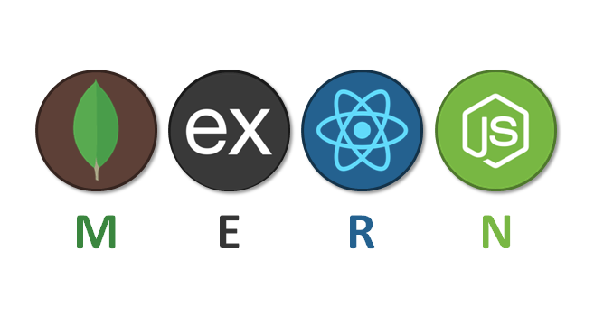
MERN Stack Development
Ritik Dwivedi

Slide 2
content
HTML and CSS
Javascript
REACT
Node JS and Express
MongoDB/Mongoose

Slide 3
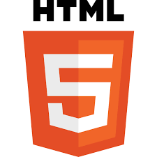
Hyper text markup language

Slide 4
Intro
HTML stands for Hyper Text Markup Language. It's the standard markup language for creating web pages.

Slide 5
Hyper: In computing, "hyper" is a prefix used to indicate links between information.
Text: Refers to the written or displayed content. In the case of HTML, this content could be anything from plain text to images and multimedia.
Markup: In the context of HTML, "markup" refers to the process of adding special notations or tags to a document to provide information about the structure of the document.

Slide 6
!Doctype
It is a declaration that specifies the document type and version of HTML being used in a web page.
It helps browsers render the content correctly.

Slide 7
html5
DOCTYPE: Simplified declaration
Structure: Enhanced for both content structuring and web applications.
Audio and Video tags
Semantic tags

Slide 8
Meta tag
The <meta> tag provides additional information about the web page, such as the author, description, and keywords.
It is located within the <head> section of the HTML document.

Slide 9
Provides a brief description of the page, often used by search engines in search results.
It is an integral part of HTML document structure and is used to enhance the document's functionality, visibility, and compatibility.
<meta charset="UTF-8">

Slide 10
Semantic html
Semantic HTML is a coding style. It is the use of HTML markup to reinforce the semantics or meaning of the content.
<article>, <navbar>, <footer>

Slide 11

Cascading Style Sheets (CSS)

Slide 12
Intro
(CSS) is a language used to style web pages. It describes how HTML elements are displayed on screen, paper, or in other media

Slide 13
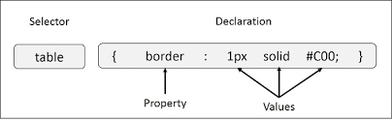
“Cascading” refers to the process of going through the style declarations and defining weight or importance to the styling rules that help the browser to select what rules have to be applied in times of conflict.

Slide 14
Box model
It describes how elements on a web page are structured and how their sizes and spaces are calculated.

Slide 15
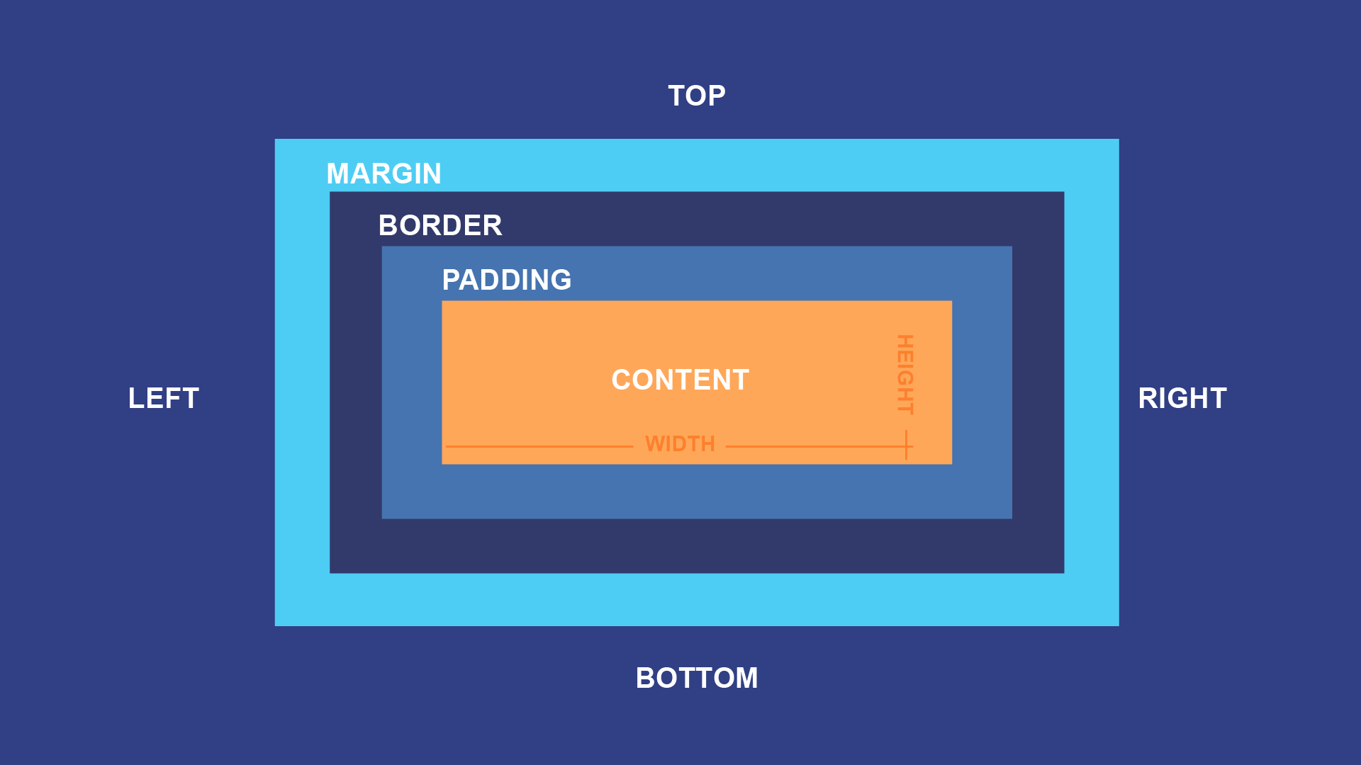
Content - The content of the box, where text and images appear
Padding - Clears an area around the content. The padding is transparent
Border - A border that goes around the padding and content
Margin - Clears an area outside the border. The margin is transparent

Slide 16
Pseudo elements and Pseudo classes
Pseudo-elements and pseudo-classes are powerful features in CSS that allow you to style elements based on their state, position, or content without adding additional HTML markup.

Slide 17
Pseudo-elements allows us to create items that do not normally exist in the document tree.
Common pseudo-elements include ::before, ::after, ::first-line, and ::first-letter.
p::before {
content: "Note: ";
color: red;
font-weight: bold;
}

Slide 18
Pseudo-classes are used to define the special states of an element. They enable you to apply styles to elements based on their state or position in the document tree.
Common pseudo-classes include :active, :focus, :visited.
a:active
{
color: green;
}

Slide 19
Position property
The `position` property in CSS is used to specify the positioning method of an element. It determines how an element is placed in the document flow and how it interacts with other elements.

Slide 20
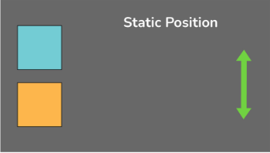
1. `static`:
Default position value.
Elements are positioned according to the normal flow of the document.
.element
{
position: static;
}

Slide 21
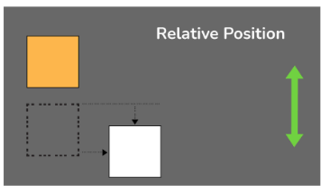
2. `relative`:
Positioned relative to its normal position.
Can be moved using the `top`, `right`, `bottom`, and `left` properties.
.element {
position: relative;
top: 10px;
left: 20px;
}

Slide 22
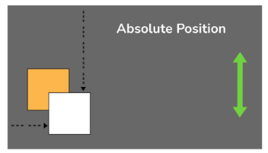
3.`absolute`:
Positioned relative to the nearest positioned ancestor (instead of positioned relative to the viewport, like fixed).
If no positioned ancestor, it's positioned relative to the initial containing block.
.element { position: absolute; top: 30px; left: 40px; }

Slide 23
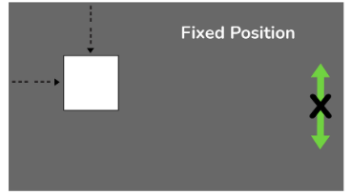
4. `fixed`:
Positioned relative to the viewport.
Stays fixed even when the page is scrolled.
.element {
position: fixed;
top: 0;
right: 0;
}

Slide 24
Display property
The display property in CSS is used to define how an HTML element should be displayed on the web page. It specifies the type of box used for an HTML element, influencing its layout and visibility.

Slide 25
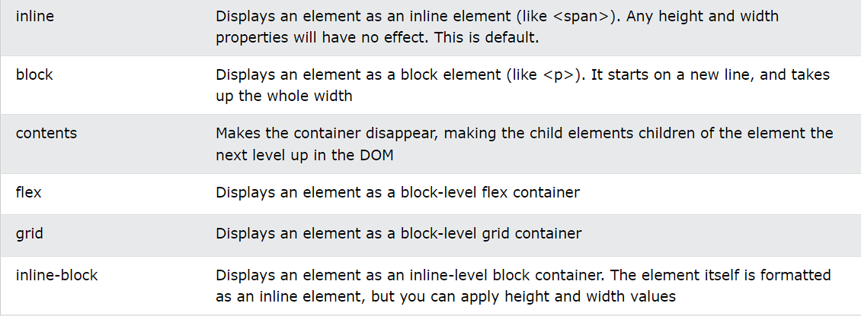

Slide 26
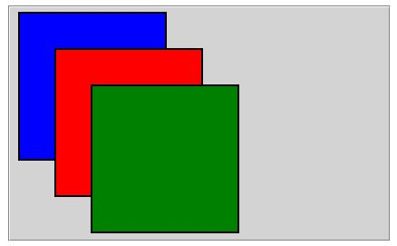
Z-index
When elements are positioned, they can overlap other elements.
The `z-index` property specifies the stack order of an element (which element should be placed in front of, or behind, the others).

Slide 27
Img
{
position: absolute;
left: 0px;
top: 0px;
z-index: -1;
}

Slide 28
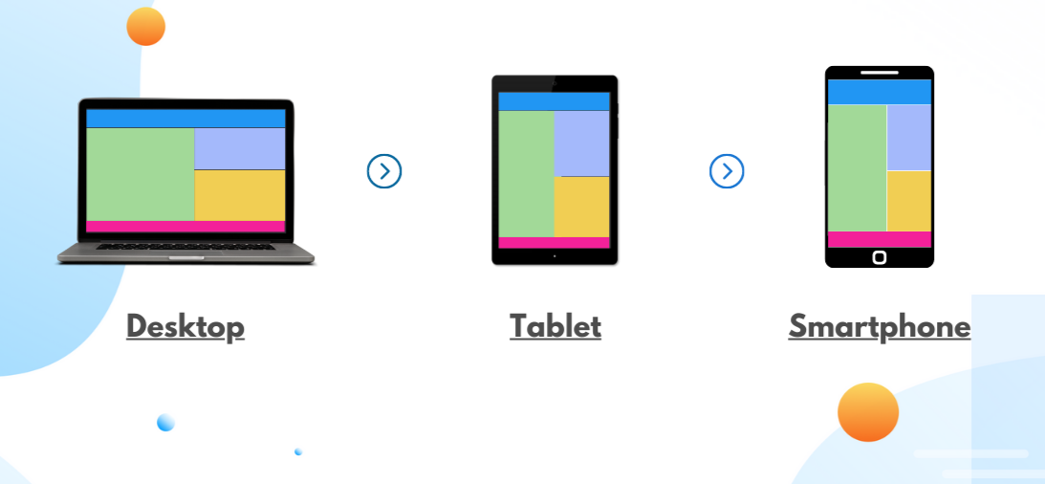
Media queries
A media query in CSS allows you to apply different styles based on the characteristics of the user's device
@media screen and (max-width: 600px)
{
body
{ background-color: lightblue; }
}

Slide 29
Benefits of using media queries:
Responsive design: Ensures your website looks and functions well on all devices, from desktops to mobile phones.
Improved user experience: Makes your website easier to navigate and interact with on different screen sizes.
SEO boost: Search engines love responsive websites, which can improve your ranking in search results.

Slide 30
flexbox
Flexbox is a layout model in CSS that gives us a way where we can flexibly arrange elements in rows or columns, making it easy to create responsive and adaptable web designs.
Note: Whenever we give display flex to parent all the child becomes block level element.

Slide 31
Think of the elements as a team:
Flex container: The team captain, holding everyone together and defining the layout direction (row or column).
Flex items: Players on the team, adjusting their size and position based on the captain's orders.
Properties: Captain's tools to control how the team works:
`flex-grow`: Determines how much an item can grow to fill available space.
`flex-shrink`: Determines how much an item can shrink when space is limited.
`justify-content`: Aligns items horizontally within the container (center, left, right, etc.).
`align-items`: Aligns items vertically within the container (center, top, bottom, etc.)

Slide 32
THANK YOU

